Slide 1
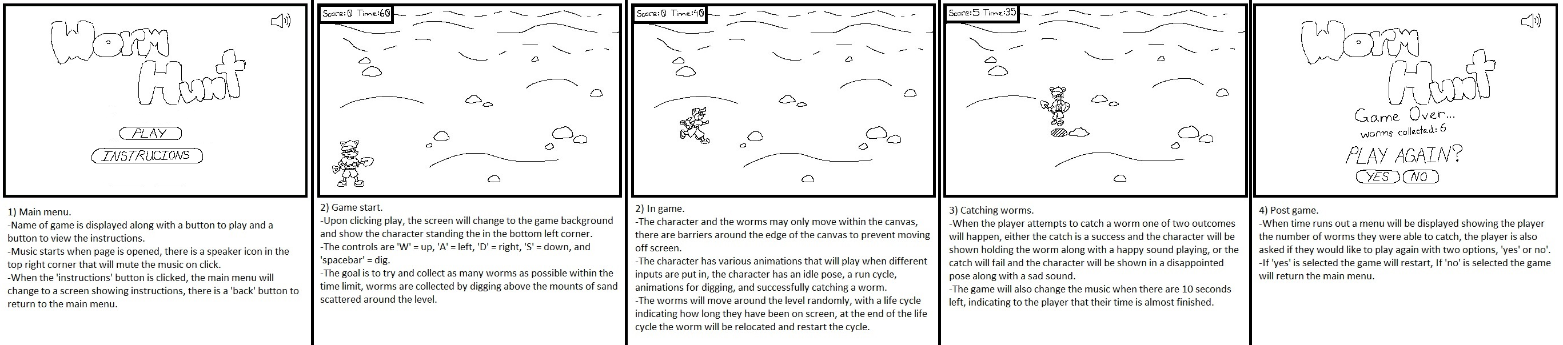
Game concept
As part of this project, we were to develop a web based interactive children’s game. The general overview was that the game should be developed using HTML and JavaScript elements (mainly canvas), to create a simple but fun experience for users on the Resort Park Adventure website.
The concept was recommended to be a short time-based challenge, where the player is tasked with running around a beach to try and catch sandworms which move around the area, spawning randomly and then disappearing after a short while.
For our game I decided on the name “Worm Hunt”, seeing as it explains the aim of the game quite well and is easily remembered. for the character, I knew that the design would have to be something that would appeal to kids and be rather simple to match the rest of the games design, I also knew that the menus and sounds should be colorful and cartoonish to match as well. From that point I was able to commence development.

Slide 2
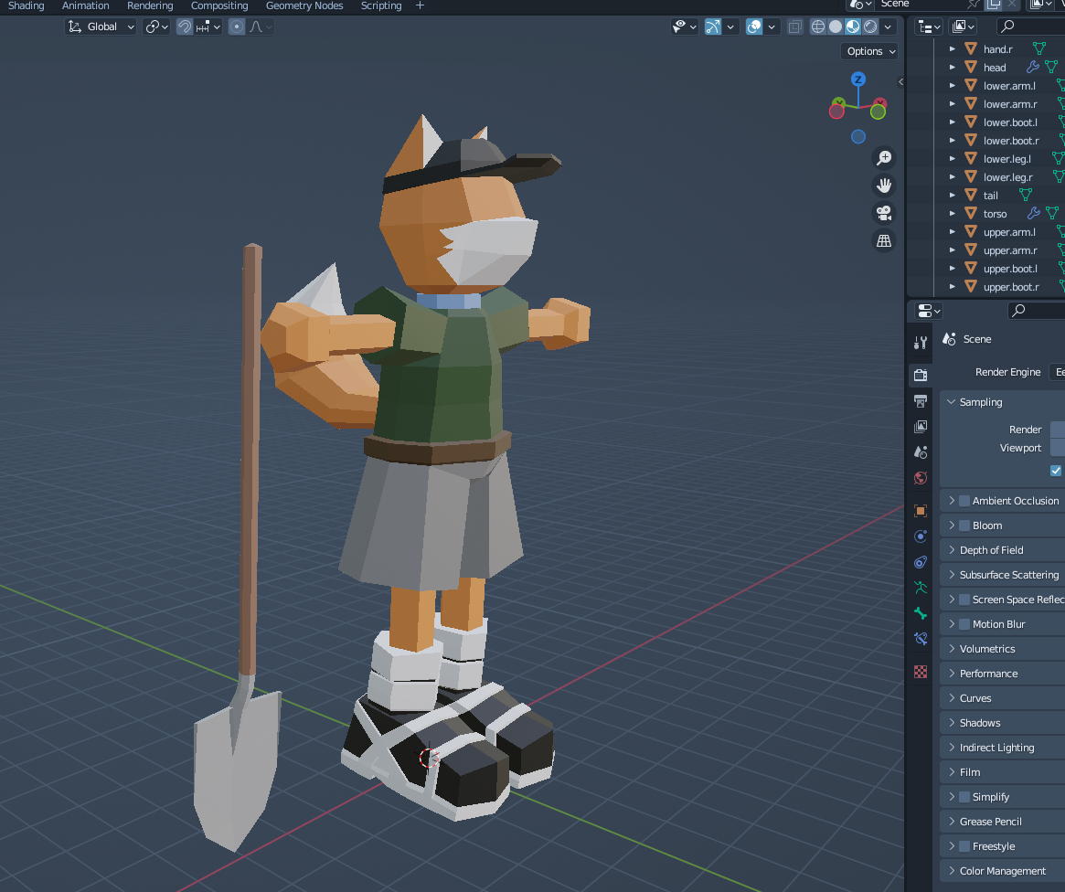
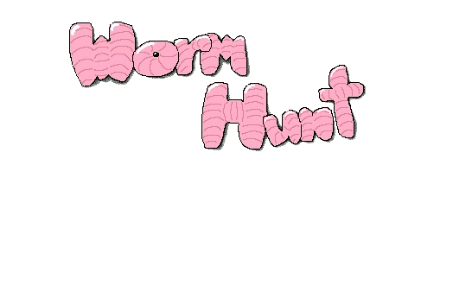
Initial design
The first assets to be made were the menus, and main character, along with their animations. For the character I initially drew a general idea of how I wanted them to look in my storyboards, opting for a fox type creature similar in appearance to other popular characters like Sonic or Klonoa. The menus I decided upon were rather simple with large bubble font type titles and colourful backgrounds. The character was made using blender as I thought having a 3D model of our character would be the easiest way to create a multitude of original sprites to be used within the game. The menu assets were drawn in MS paint as I liked how using a lower resolution canvas with the pencil tool gives everything a pixelated look as well as the general simplicity of the program.

Slide 3
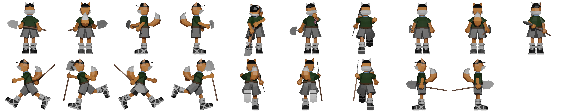
Development
With the newly created assets, next was development of the game loop and interactive interface, the game itself was created using a JavaScript canvas, utilizing a spritesheet with multiple stills of various animations which the game would cycle through according to the player’s inputs to simulate the character dynamically moving around the canvas. The menus of the game were developed using HTML elements (mainly images) which would simply overlay on top of the canvas and be hidden or displayed based on user action or events. For example, the in-game timer system worked through a value, e.g., 180, representing 3 minutes, which would be subtracted by 1 through a function running on a 1000 millisecond interval, and would then display the background image along with images containing click events to simulate buttons once the value reached 0, therefore providing a simple, yet effective game over mechanic.

Slide 4
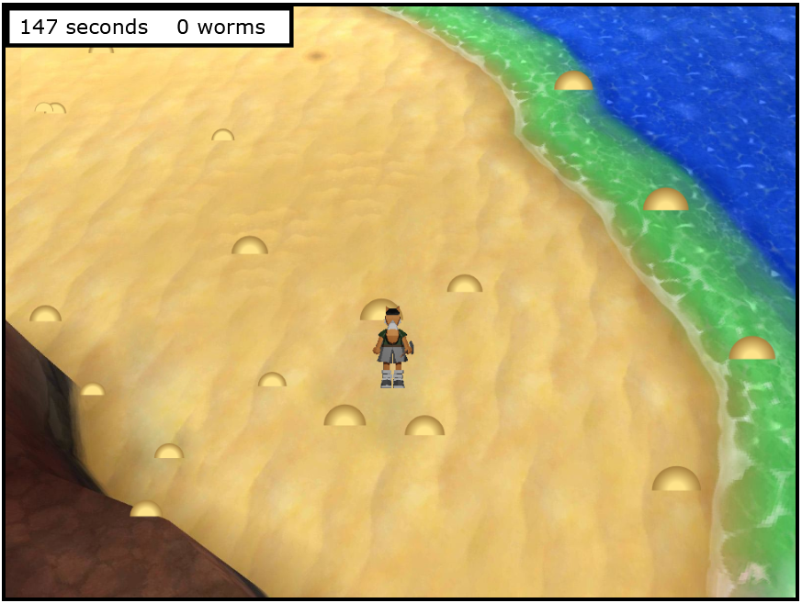
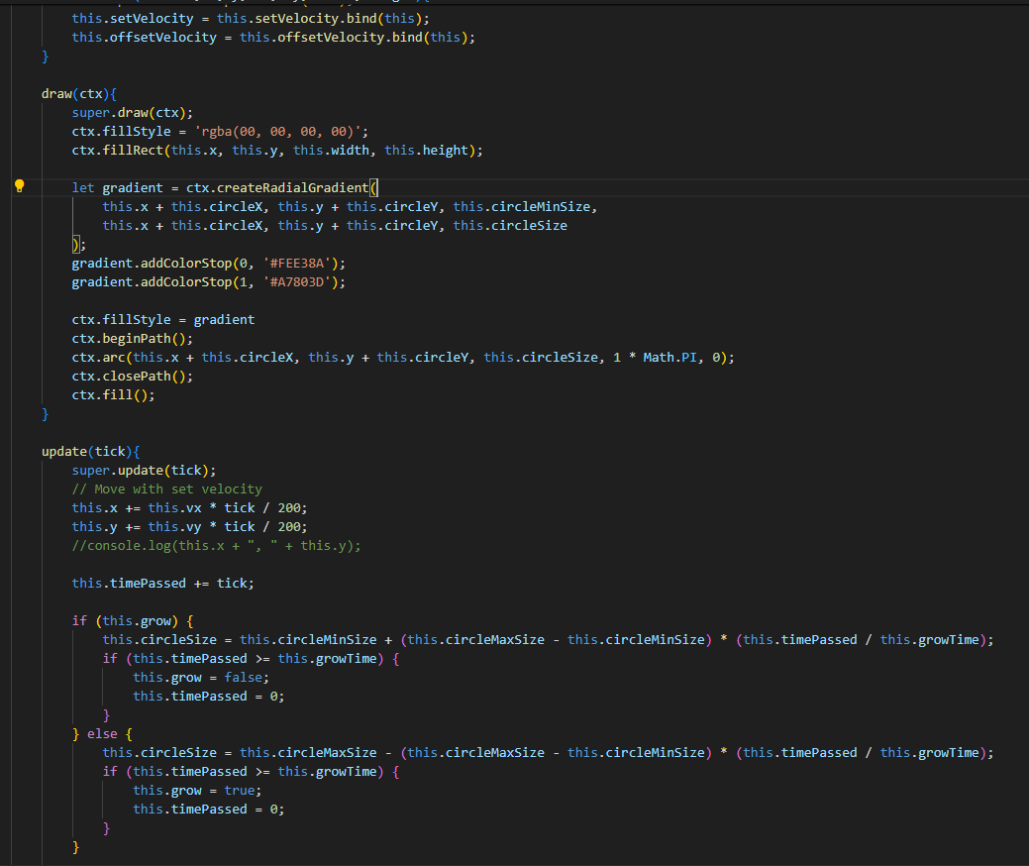
Development
The next and most challenging part of the project was the development of the worms and scoring system. It was clear that the worms were to be canvas-drawn objects with the appearance of semi-circles which would have a random spawn position and move in a random direction before bouncing off the canvas bounds and taking a new random path, similar to the famous DVD screensaver. They would also have to be dynamic, changing in size before disappearing, and allowing for interaction from the player to be collected and provide score to a counter. This was achieved by drawing the worms as a semi circles filled with a gradient using ctx.arc and ctx.createRadialGradient, on top of a square filled with an alpha channel of “00”, making them transparent and providing an easily calculated hitbox.
The logic for the score system worked as follows, the system would detect if the invisible square was in contact with the player’s sprite, and if the player was to perform the “dig” action while in contact, both the square and semi-circle would be deleted and +1 would be added to a score counter. The logic for the worm’s lifecycle (growing and shrinking before disappearing), worked through a timer close to that of the game timer. The visible semi-circle would have a small default size, taking 5 seconds to grow to its maximum size before taking 5 more seconds to shrink to its minimum size, whilst this is happening, from the moment a worm spawns, a 10 second timer is started which triggers the worm to be deleted once the time has ended.

